Slide 1
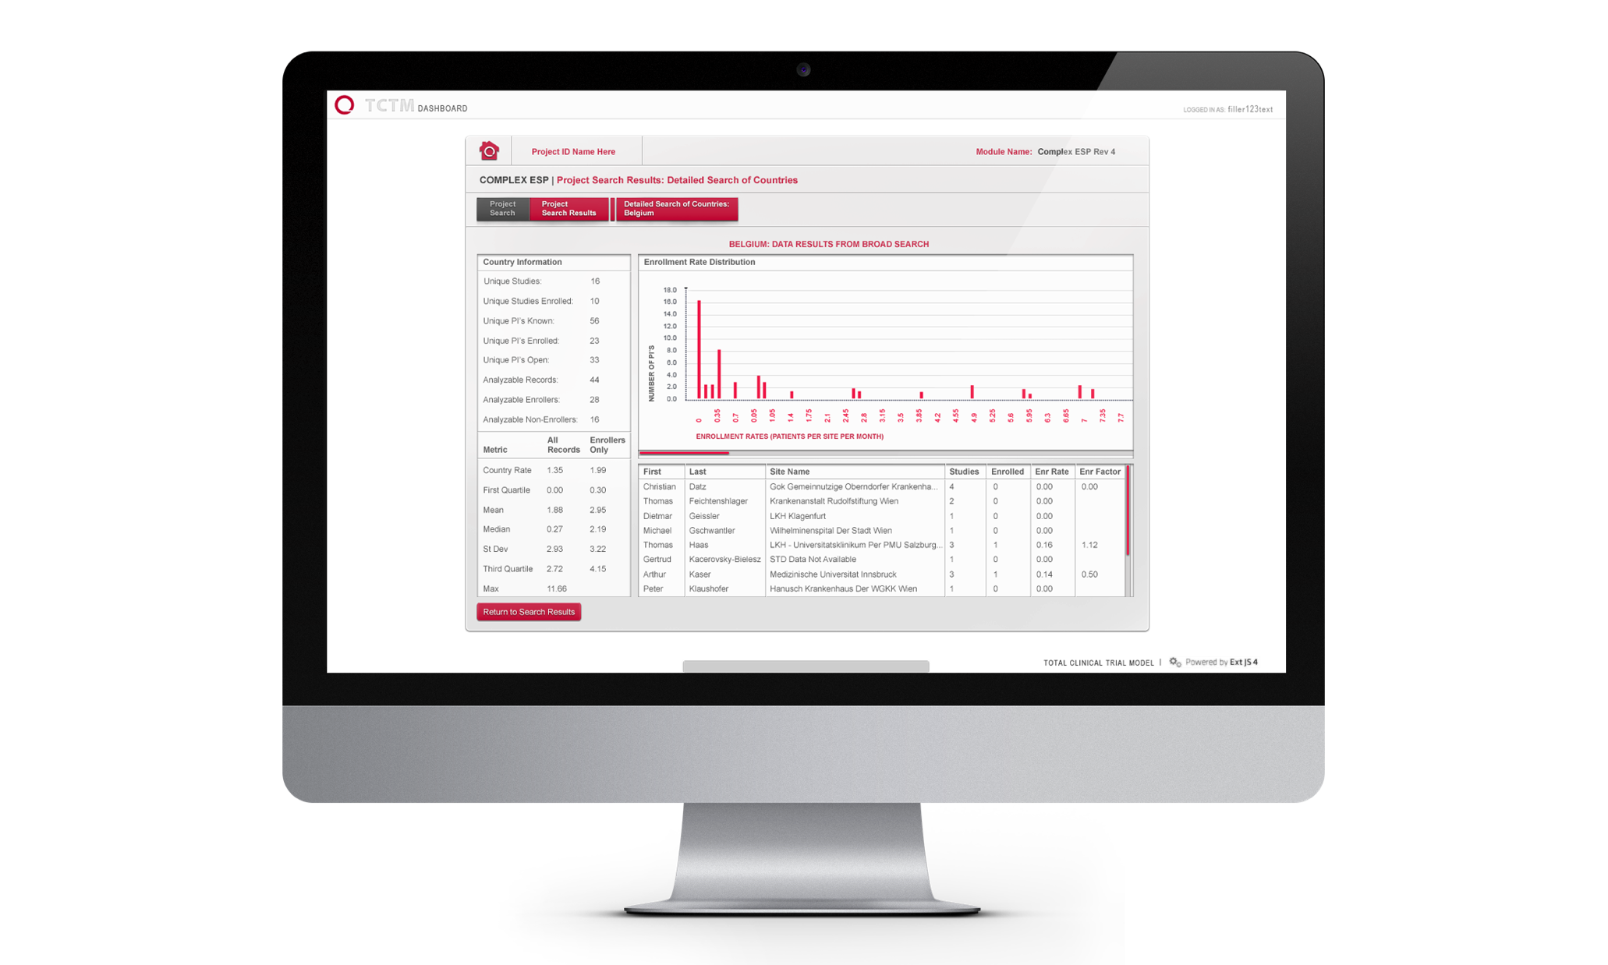
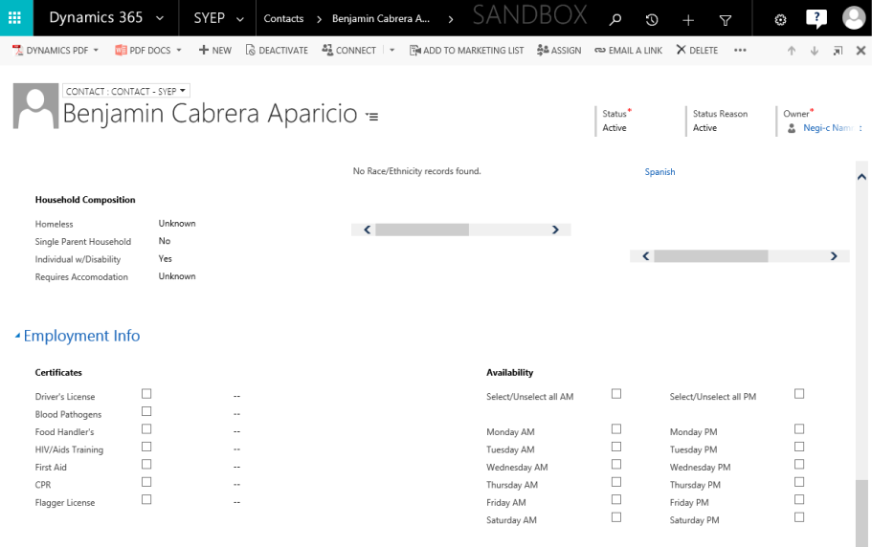
City of Seattle – Dynamics 365
Business Need
Replace/migrate the current SYEP application to Dynamics CRM
Eliminate manual data entry processes and improve operational efficiency
Develop integrations and stronger connectivity with other agency applications
Implement automated communication and workflow tools
What We Did
Affirma worked with the City of Seattle SYEP to perform the following:
Requirements Analysis: Discovery and refinement of business, functional, and application-specific requirements for the CRM system
Design: Affirma’s team developed documentation which detailed the proposed solution’s functionality, architecture, and technical approach
Data Migration: Data migration and transformation from SQL database to the new Dynamics CRM application
Development: Implementation of Dynamics CRM customizations including workflows, javascript, plugins, and basic configuration to align with requirements

